Slide 1
The Story of how the Bloody Mary game started
How a bunch of things came together and turned into a joke people play on each other and themselves.

Slide 2
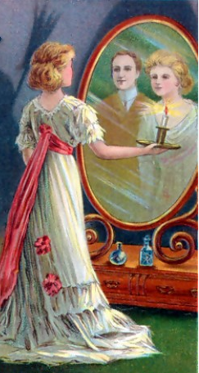
Origins
The first people who played the Bloody Mary game were young women who wanted to know who their future husband would be. They would walk up some stairs backwards with a candle and a mirror, and their husband was supposed to appear in the mirror.

Slide 3
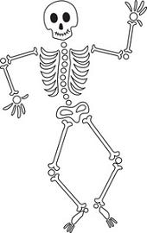
Origins
If the young woman was going to die before she had a chance to marry, she was supposed to see a skeleton or some blood in the mirror.

Slide 4
How the Game Changed
Over time, people forgot the husband part, and just remembered the spooky part. They started to say it was a woman who appeared in the mirror instead of a man. They called her Bloody Mary because of the blood part of the original game. Some people said she was friendly, and some people said she was scary.

Slide 5
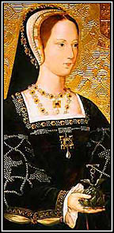
How the Game Changed
Some people started saying Bloody Mary had a baby that died. They were actually thinking of a real person from history who was Queen of England from 1496 to 1533. When Mary Tudor got pregnant, her babies died before they were born. This sad circumstance led some people to call her Bloody Mary.

Slide 6
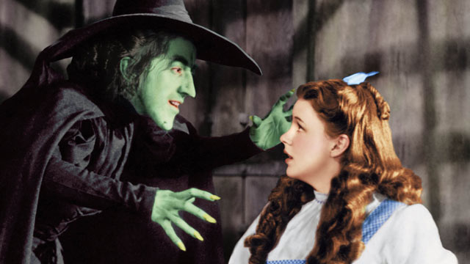
How the Game Changed
As time went on, all kinds of other things got added to the game. Another fairy tale got mixed in about a witch from Tennessee called the Bell Witch. Some people started saying that was the name of the woman who appeared in the mirror.

Slide 7
How the Game Changed
Now there are all kinds of ideas about Bloody Mary and the Bell Witch, and even other people or things that might appear in a mirror when the lights are off.
Different ideas seem to come from different regions of
the United States, but there are even some versions of
the game that happen in other countries.

Slide 8
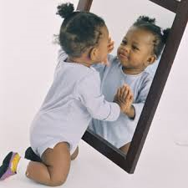
What is Really Going On
Human eyes and brains are sometimes fooled into seeing something that isn’t there. This happens very easily in low light. When it happens in a mirror, psychologists call it the “strange face illusion”

Slide 9
What is Really Going On
Another interesting illusion is called “Troxler’s fading”. If you stare at something long enough, sometimes your eyes start seeing something else. Stare at the cross in the center of this circle, and the dots will appear to fade and disappear.

Slide 10
Just a Game
So knowing about the history, changes, and explanations of the Bloody Mary game, we see that in the end, it’s just a game. We enjoy being scared because it makes our bodies release adrenaline, which
is a chemical that makes us feel excited and full of energy. It’s also fun to laugh with friends about being scared.

